Slide 1

Hospital Management System Presentation by: Turvon Al Weah

Slide 2
Agenda
Introduction
Development of ER Diagram
Database Creation
Normalization Process
Data Manipulation Using SQL Queries
Conculsion

Slide 3

Introduction

Slide 4
Introduction and Scope of Project
This is a Hospital Management System that will manage and store critical data, essential to the operations of the hospital. This DBMS will manage patient care, staff coordination, appointment scheduling, treatment records, and billing procedures. This system will ensure that the operations at the hospital are organized and running optimally.
In this presentation, I will walk you through how I developed this Hospital Management System, showing the process of visualizing the relationships between entities using ER Diagrams, creating a database in Lucid Chart, normalizing data up to 3NF, and using SQL for data retrieval, manipulation, and storage.
Project Scope: patient care, staff coordination, scheduling, treatment records, and financial billing.
Notes:
Here’s an introduction and quick overview of the project. Once created, the Hospital Management System is going to manage the operations at the hospital. The following operations will be streamlined through the DBMS, including patient care, staff coordination, appointment scheduling, treatment records, and billing procedures. In the next slides, I will elaborate on the steps I took to develop this system, showing the process of visualizing the relationships between entities using ER Diagrams, creating a database in Lucid Chart, normalizing data, and using query language, specifically SQL, to manage the database.

Slide 5

Development of ER Diagram

Slide 6
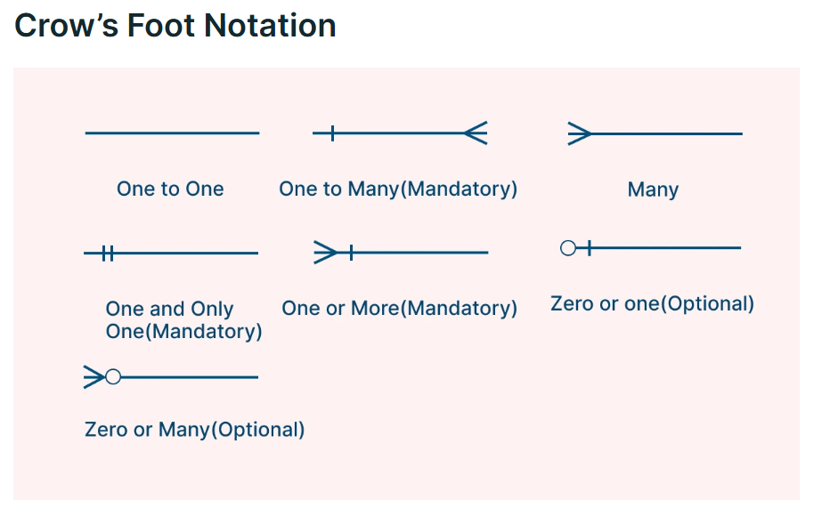
ERD Development
The ER Diagram was used to conceptualize the relationships between entities in the database. In Lucidchart, the entities were created with attributes and cardinalities between entities mapped out. Ideal for technical teams designing detailed, implementation-ready data (Keerthisena, 2026).
Relationships:
Note. From "Cardinality symbols in ER diagrams: Types & notations + free templates," by Y. Keerthisena, 2026, Creately (https://creately.com/guides/cardinality-symbols/). Copyright 2026 by Creately.
Notes:
To clearly visualize the relationships between the data tables, I use Lucid Chart. This tool is effective in creating ERDs using crows-foot notation to show relations between tables. In this image, you can see many different kinds of relational data tables that can exist. One-to-one, in the case of the hospital management system will be a patient to a medical bill. The patient has exactly one bill.

Slide 7
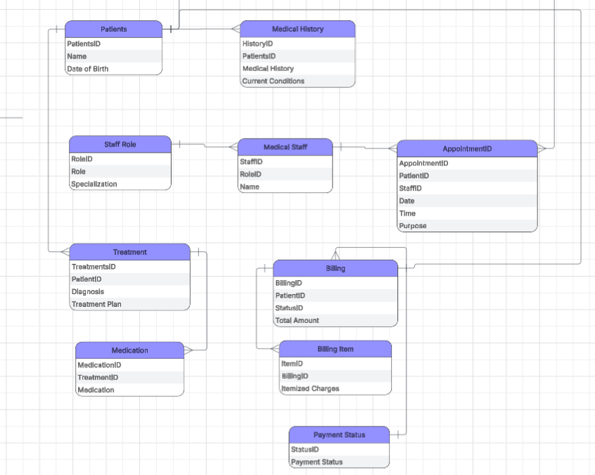
ERD Development
Here are the key entities and attributes
Relationships:
Patients – Medical History (1-N)
Patients - Treatment (1:N)
Patients - Billing (1:1)
Treatment – Medication (1:N)
Billing – Billing Item (1:N)
Payment Status – Billing (1:N)
Patient – Appointment (1:N)
Medical Staff – Appointment (1:N)
Notes:
The five entities each map to a real operational area of the hospital. The cardinalities show that one patient can have many appointments, many treatments and many billing records, while one staff member can conduct many appointments.

Slide 8
Creation of Database

Slide 9
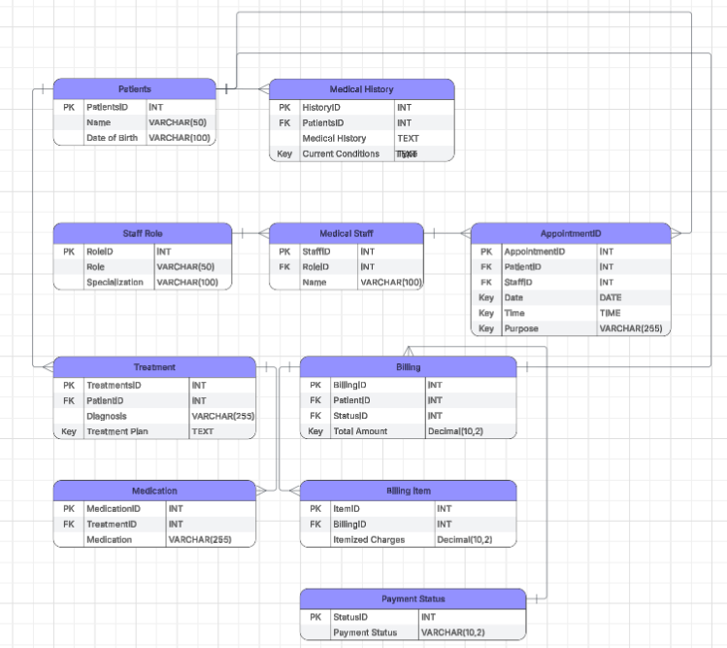
The Database
PatientID, StaffID, AppointmentID, TreatmentID, BillingID, etc., are all primary keys
Patient_ID appears as a foreign key in Appointments, Treatments and Billing to link records back to the patient.
Staff_ID appears as a foreign key in Appointments. Treatment_ID appears as a foreign key in Billing.
Notes:
Here you can see the database schema, where the appropriate data type is assigned to an attribute. Also, assigned Primary and Foreign Keys are linked to the different tables. These keys are unique identifiers for each record.

Slide 10
Normalization Process

Slide 11
Normalization Process: 1NF → 3NF
Database normalization is a database design process that organizes data into specific table structures. It helps to improve data integrity, prevent data anomalies, minimize data redundancy, and bolster query performance (Gomstyn & Jonker, 2025).
1NF
First Normal Form
All values are made atomic. One value per cell, every row uniquely identified.
↓
2NF
Second Normal Form
Partial dependencies are removed. Each non-key attribute depends on its own full primary key. FKs link the tables.
↓
3NF
Third Normal Form
Eliminates transitive dependencies. No attribute depends on a non-key
Notes:
I applied 3 stages of normalization to the data.
1NF, enforces atomicity. One value per cell and a composite primary key is assigned.
At 2NF, partial dependencies are removed. Every non-key attribute is dependent on the whole primary key. Ex. Staff Name, & Specialization must depend on StaffID.
3NF, removes the transitive dependency. Example, is specialization depending on role in the medical staff table in 2NF. This was extracted in Staffrole table, in 3NF.

Slide 12
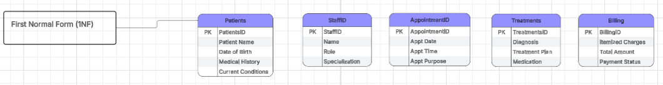
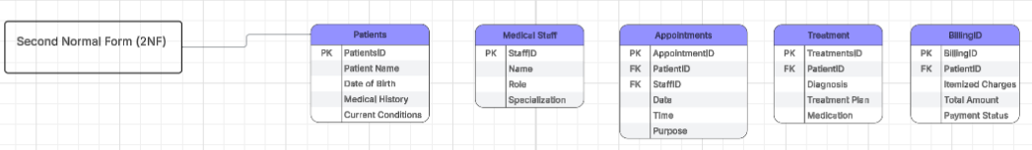
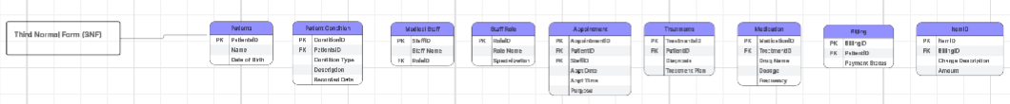
Normalized Tables
Notes:
On this slide, we can see how the data table was normalized for a Hospital Operations Management System, using the 1NF – 3NF process.

Slide 13
SQL Queries

Slide 14
Normalized Tables
SQL is a standard language for accessing and manipulating databases(W3Schools, n.d.).
SELECT
Retrieve data from single and multiple tables
RIGHT JOIN
All rows from right table, NULLs where no match
WHERE
Filter records using conditions and operators
INSERT
Add two new records to the database
INNER JOIN
Combine matching rows from two or more tables
UPDATE
Modify two existing records based on conditions
LEFT JOIN
All rows from left table, NULLs where no match
DELETE
Remove two records with care and conditions
Notes:
This slide covers eight SQL operations. All queries were run on TiDB Cloud Serverless, a free MySQL-compatible cloud database.
Single Table Select:
I used this statement to select all columns from the Patients table in the hospital management database, and another to Select patients where Current_Conditions is 'Fever’
Multiple Table Select and Joins:
Select patient names and their appointment dates and purpose
And Joins, joins Patients and Appointments on PK Patient_ID
WHERE CLAUSE:
I used a where clause to retrieve data that fits the condition, "Pending.“
INSERT STATEMENT:
This statement was used to insert two new records into the data table, Medical Staff.
UPDATE STATEMENT
This statement was used to update the table Patients by adding a new record.
DELETE STATEMENT
This statement was used to delete records from the Medical Staff table that had specific staff_IDS

Slide 15

Conculsion
The Hospital Management System was built on three principles, including data integrity, efficiency, and scalability. Normalizing to 3NF across five tables eliminated redundancy and data anomalies. The normalized structure also scales naturally, as new entities can be added without restructuring existing tables, keeping query performance predictable as the system grows.
References
Gomstyn, A., & Jonker, A. (2025, June 16). What is database normalization? IBM. https://www.ibm.com/think/topics/database-normalization
Keerthisena, Y. (2026, January 21). Cardinality symbols in ER diagrams: Types & notations + free templates. Creately. https://creately.com/guides/cardinality-symbols/
W3Schools. (n.d.). Introduction to SQL. Refsnes Data. https://www.w3schools.com/sql/sql_intro.asp
Notes:
The Hospital Management System was built on data integrity, efficiency, and scalability. Normalizing to 3NF across five tables eliminates redundancy and data anomalies. A change to any record only needs to be made in one place. Foreign keys enforce referential integrity automatically at the database level, and JOIN operations allow complex reporting in a single query. The schema also scales cleanly; new modules like pharmacy or insurance can be added as separate tables without touching existing ones, keeping performance predictable as the system grows.

